Slide 1

Team Details
Team name: HomeGuardians
Team leader name: Rathnagar S
Problem Statement: AI-Assisted Property Inspection for Safer Homes

Slide 2

Brief about the idea/protoype
AI-Assisted Property Inspection Workspace is a solution that helps home buyers, tenants, and regulators systematically detect hidden defects in new or under-construction properties. Using inspection notes, the workspace classifies defects into categories (structural, electrical, plumbing, finishing), assigns risk scores to each room and property, and generates plain-language summaries highlighting key issues. The prototype is implemented in Snowflake + Python + Streamlit, offering interactive dashboards, risk metrics, and severity-highlighted tables.

Slide 3
Opportunities
How different is it from other existing ideas?
Automatically analyzes inspection notes instead of just storing raw data.
Aggregates room-level defects into property-level risk scores.
Generates plain-language summaries, making technical findings easy to understand.
Works in real-time with Snowflake + Python without requiring expensive AI tools.
How will it solve the problem?
Detects hidden defects like cracks, leaks, or exposed wiring early.
Provides quantified risk scores for rooms and properties.
Summarizes findings clearly for families, tenants, and regulators, enabling informed decisions and safer housing.
USP of the proposed solution
Plain-language summaries for quick understanding.
Room-to-property risk aggregation for actionable insights.
Interactive dashboard for real-time inspection analysis.
Lightweight and extendable, ready to integrate AI or image analysis in the future.

Slide 4
List of features offered by the solution
Features Offered
Property Selection: Choose any property to inspect from a dropdown.
Room-Level Findings: Displays inspection notes per room.
Defect Classification: Categorizes defects as structural, electrical, plumbing, finishing, or ok.
Severity & Risk Scoring: Assigns severity levels (high, medium, low) and calculates room & property risk scores.
Plain-Language Summary: Auto-generates readable summaries of key issues.
Interactive Dashboard: Filterable tables and real-time updates.
Severity Highlighted View: Color-coded table for quick visualization of risk levels.
Export Option: Save data for reporting or regulatory purposes.

Slide 5
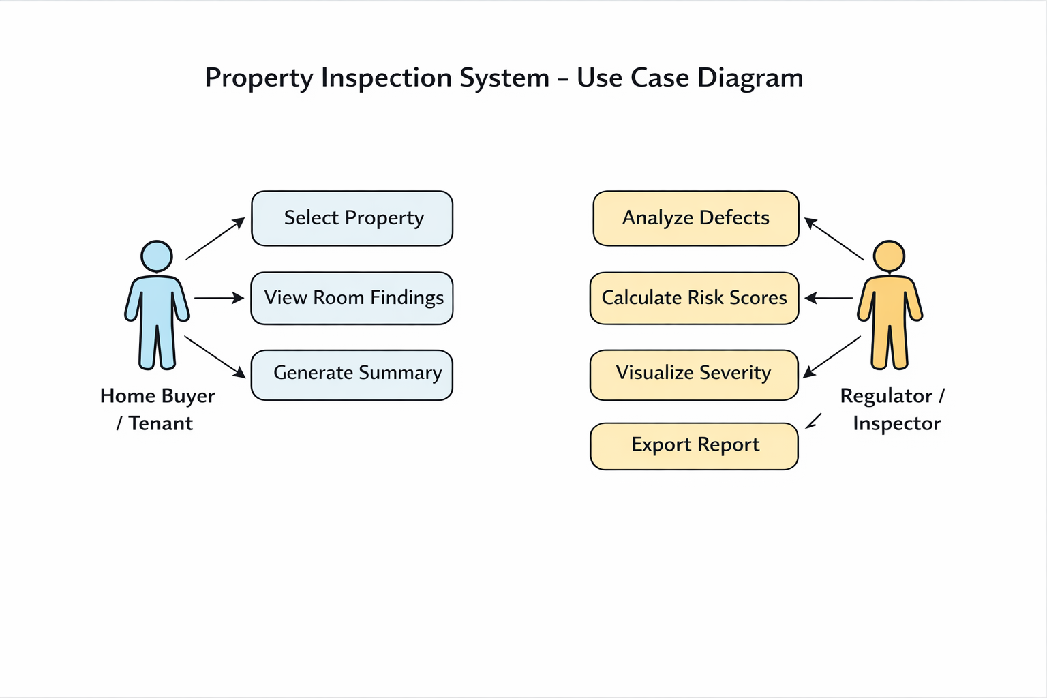
Use-case diagram

Slide 6
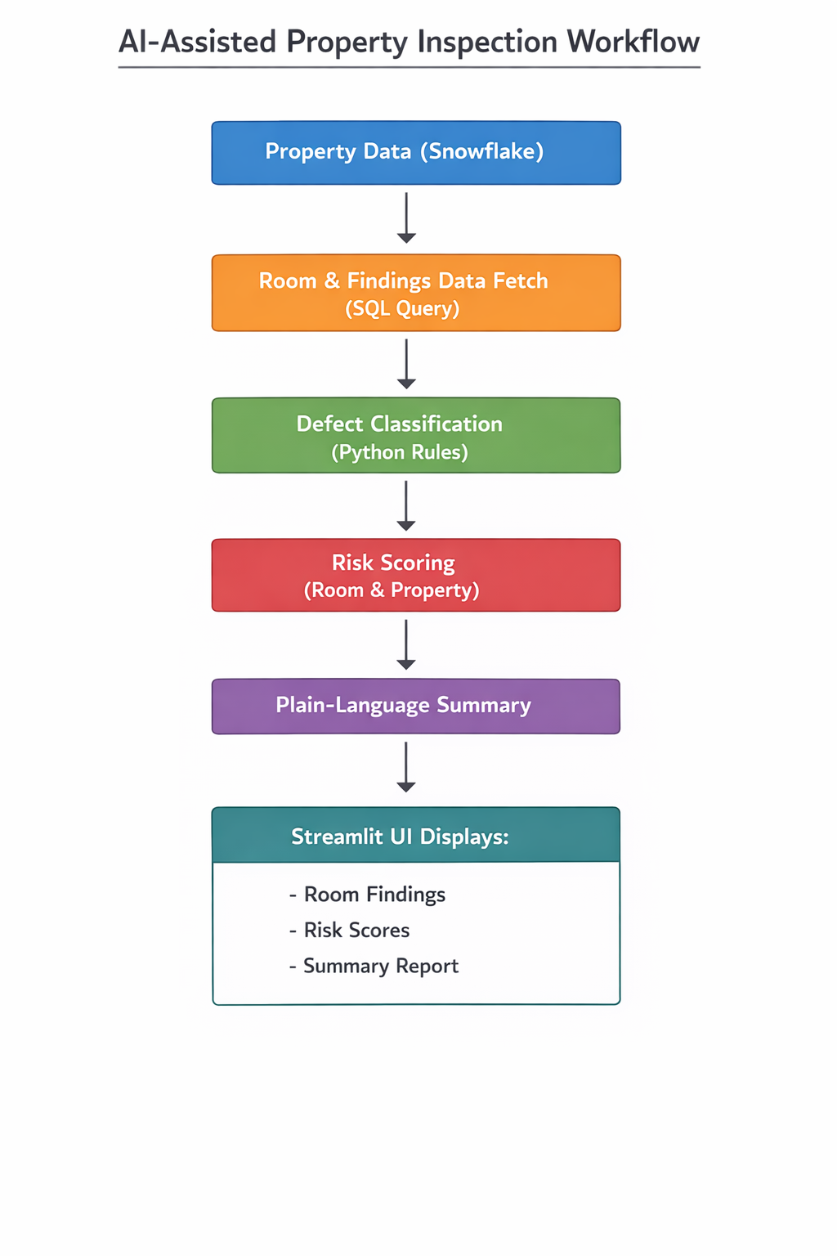
Architecture diagram of the proposed solution

Slide 7
Tech Stack
Data Layer Snowflake – Central data warehouse for structured inspection dataSQL / Worksheets – Data querying and transformation
Processing & Logic Python – Rule-based defect classification and risk scoring Snowflake Snowpark – Executes Python logic close to data
AI / Intelligence Rule-based AI (Explainable) – Defect categorization & severity detection (Future-ready) Snowflake Cortex / AI SQL – For LLM-based summarization and predictions
Application Layer Streamlit (in Snowsight) – Interactive UI for inspectors and decision-makers
Visualization Streamlit native components – Tables, metrics, highlighted severity (no external plotting libraries)
Deployment Snowflake Native App / Streamlit App – No external infrastructure required

Slide 8
Snowflake tools and technology used
Snowflake Data Cloud – Centralized data storage & compute
Snowflake SQL (Worksheets) – Data querying
Snowpark for Python – In-database defect classification & risk scoring
Streamlit in Snowsight – Interactive UI & summaries
RBAC & Managed Security – Secure, role-based access

Slide 9
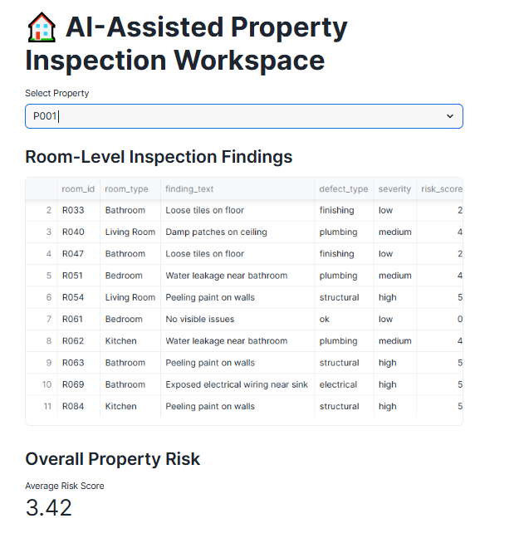
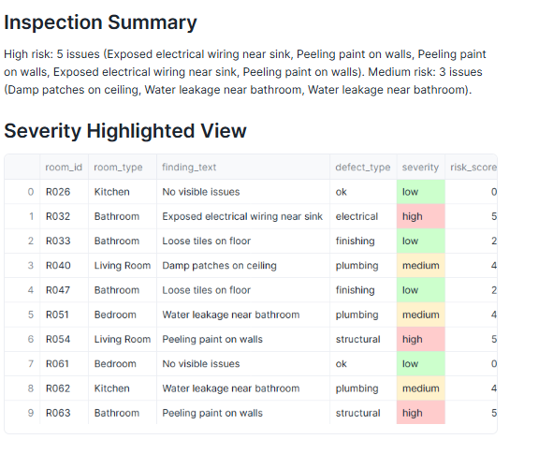
Snapshots of the prototype

Slide 10
Estimated implementation cost (optional)
This prototype is built entirely using Snowflake’s free trial capabilities — no paid tools or infrastructure required.

Slide 11
Additional Details/Future Development (if any)
Integrate Snowflake Cortex / AI SQL for ML-based defect classification and smarter summaries
Add Dynamic Tables + Tasks for continuous, real-time risk score updates
Support unstructured inputs (inspection notes, PDFs) using Snowflake stages
Introduce trend analysis to track property risk over time
Enable role-based access for inspectors, regulators, and owners
Scale to portfolio-level risk dashboards across cities or regions
Key takeaway: The solution is production-ready and can evolve into a fully automated, AI-driven inspection intelligence platform with minimal changes.

Slide 12
GitHub Link
https://github.com/Rathnagar/AI_Assited_Inspection_Worspace/blob/main/README.md
Demo video URL:
https://drive.google.com/file/d/1IwOH-IS2-WoZyMU39T4TAl18qUgkTmMT/view?usp=drive_link

Slide 13


